Slide 1



Amazon Web Services
(AWS)
2. Identity and Access Management - IAM

Slide 2


IAM: Users & Groups
IAM = Identity and Access Management
Root account created by default, shouldn’t be used or shared
Users are people within your organization, and can be grouped
Groups only contain users, not other groups
Users don’t have to belong to a group, and user can belong to multiple groups
Group: Developers
Group: Operations
Group: Audit Team
Bob
Alice
David
Ann
Jack
Jane

Slide 3
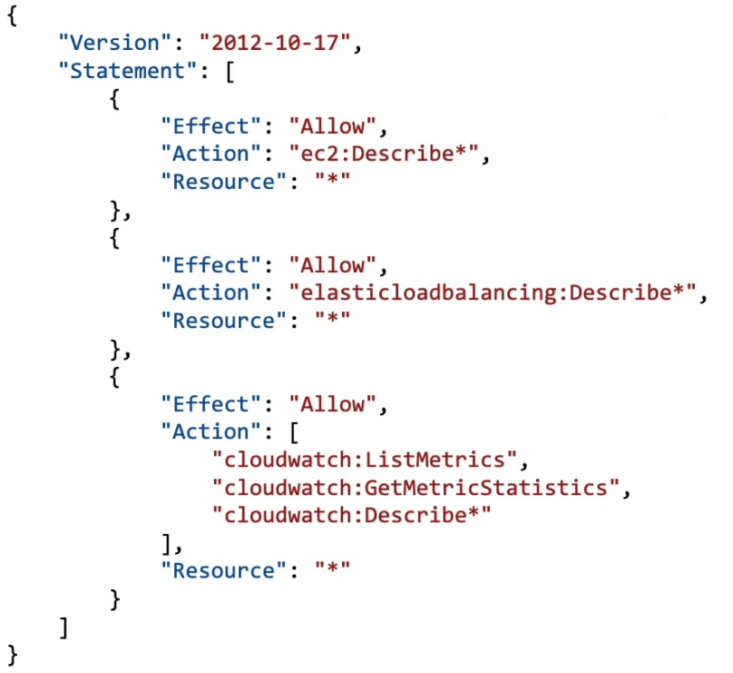
IAM: Permissions
Users or Groups can be assigned JSON documents called Policies
These policies define the permissions of the users
In AWS you apply the least privilege principle: don’t give more permissions than a use needs

Slide 4

Demo:
IAM Users & Groups Hands On

Slide 5

IAM: Policies Inheritance
Group: Audit Team
Group: Developers
Group: Operations
Inline
Bob
Alice
David
Ann
Jack
Jane

Slide 6
IAM Policies Structure
{
“Version”: “2012-10-17”,
“Id”: “S3-Account-Permissions”,
“Statement”: [
{
“Sid”: “1”,
“Effect”: “Allow”,
“Principal”: {
“AWS”: [“arn:aws:iam::123456789012:root”]
},
“Action”: [
“s3:GetObject”,
“s3:PutObject”
],
“Resources”: [“arn:aws:s3:::mybucket/*” ]
}
]
}
Consists of
  Version: policy language version, Always include “2012-10-17”
  Id: an identifier for the policy (optional)
  Statement: one or more individual statement (required)
Statement consists of
  Sid: an identifier for the statement (optional)
  Effect: whether the statement allows or denies access (Allow, Deny)
  Principal: account/user/role to which this policy applied to
  Action: List of actions this policy allows or denies
  Resources: list of resources to which the actions applied to
  Condition: conditions for when this policy is in effect (optional)

Slide 7
Demo:
IAM Policies Hands On

Slide 8
IAM – Password Policy
Strong password = higher security for your account
In AWS, you can setup a password policy:
  Set a minimum password length
  Require specific character types:
    Including uppercase letters
    Lowercase letters
    Numbers
    Non-alphanumeric characters
Allow all IAM users to change their own passwords
Require users to change their password after some time (password expiration)
Prevent password re-use

Slide 9

Multi Factor Authentication - MFA
Users have access to your account and can possibly change configuration or delete resources in your AWS account
You want to protect your Root Accounts and IAM users
MFA = password you know + security device you own
Main benefit of MFA:
if a password is stolen or hacked, the account is not compromised
Password
+
⇨
Successful Login
Alice

Slide 10
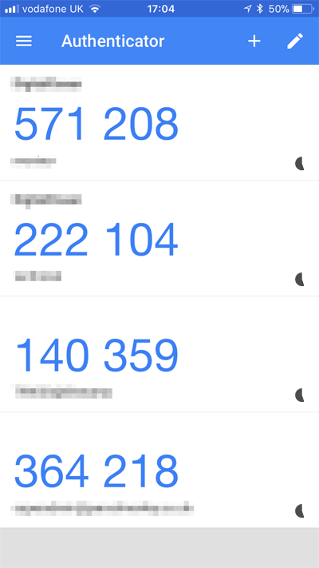
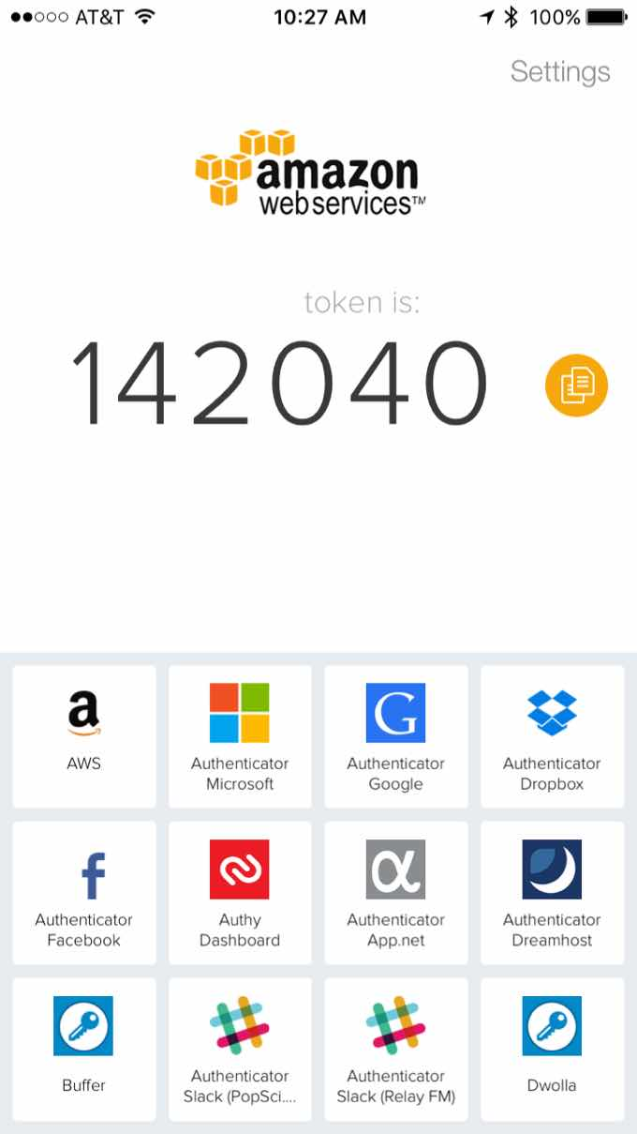
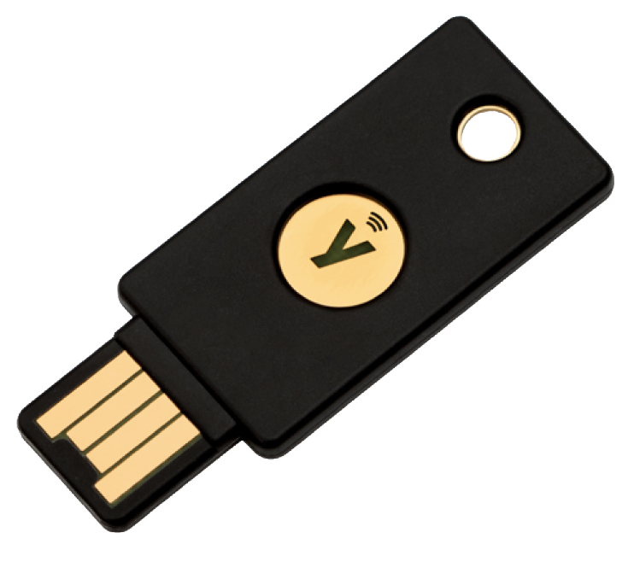
MFA devices options in AWS
Google Authenticator
(phone only)
Authy
(multi-device)
YubiKey by Yubico (3rd party)
Support for multiple token on a single device
Support for multiple root an IAM users
Using a single security key

Slide 11

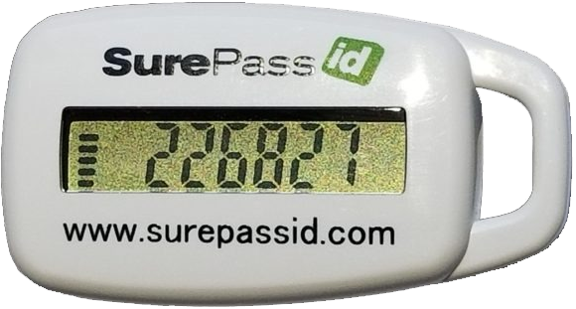
MFA devices options in AWS
Hardware Key Fob MFA Device
Hardware Key Fob MFA Device for
AWS GovCloud (US)
Provided by Gemalto (3rd party)
Provided by SurePassId (3rd party)

Slide 12
How can users access AWS?
To access AWS, you have three options:
  AWS Management Console (protected by password + MFA)
  AWS Command Line Interface (CLI): protected by access keys
  AWS Software Developer Kit (SDK) – for code: protected by access keys
Access Keys are generated through the AWS Console
Users manage their own access keys
Access Keys are secret, just like a password. Don’t share them

Slide 13
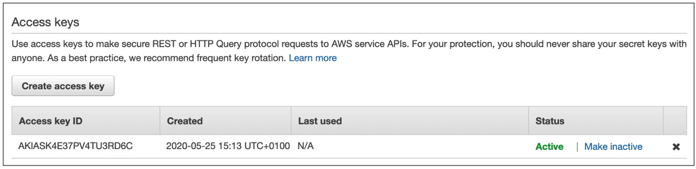
Example Access Keys
Access Key ID: AKIASK4E37PV4983d6C
Secret Access Key: AZPN#zojWozWCndlijhB0Unh8239albzbzO5fqqkZq

Slide 14
What is the AWS CLI
A tool that enables you to interact with AWS services using commands in your command-line shell
Direct access to the public APIs of AWS services
You can develop script to manage your resources
It’s open-source https://github.com/aws/aws-cli (v.1)
https://github.com/aws/aws-cli/tree/v2 (v.2)
Alternative to using AWS Management Console

Slide 15
What is the AWS SDK
AWS Software Development Kit (AWS SDK)
Language-specific APIs (set of libraries)
Enables you to access and manage AWS services programmatically
Embedded within your application
Supports
  SDKs (JavaScript, Python, PHP, .NET, Ruby, Java, Go, Node.js, C++)
  Mobile SDKs (Android, iOS,…)
  IoT Device SDKs (Embedded C, Arduino…)
Example: AWS CLI is built on AWS SDK for Python

Slide 16
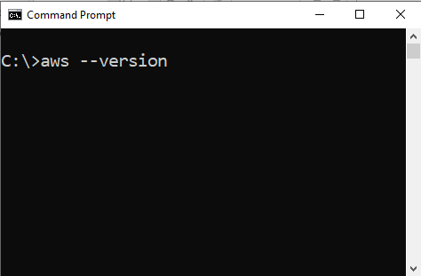
AWS CLI setup
Download from:
https://docs.aws.amazon.com/cli/latest/userguide/install-cliv2-windows.html

Slide 17
IAM Roles for Services
Some AWS services will need to preform actions on your behalf
To do so, we will assign permissions to AWS services with IAM Roles
Common roles:
  EC2 Instance Roles
  Lambada function roles
  Roles of CloudFormation

Slide 18
IAM Security Tools
IAM Credentials Report (account-level)
  A report that lists all your account’s users and the status of their various credentials
IAM Access Advisor (User-level)
  Access advisor shows the service permissions granted to a user and when those services were last accessed
  You can use this information to revise your policies

Slide 19
IAM Guidelines & Best Practices
Don’t use the root account except for AWS account setup
One physical user = One AWS User
Assign users to groups and assign permissions to groups
Create strong password policy
Use and enforce the use of Multi Factor Authentication (MFA)
Create and use Roles for giving permissions to AWS services
Use Access Keys to Programmatic Access (CLI / SDK)
Audit permissions of your account with IAM Credentials Report
Never share IAM users & Access Keys

